Slide 1

Artificial Intelligence and Machine Learning
Linear Regression

Slide 2
Lecture 1: Outline
Linear Regression
Optimization
Applications

Slide 3
Motivation
Linear Regression is “still” one of the more widely used ML/DL Algorithms
Easy to understand and implement
Efficient to Solve
We will use Linear Regression to Understand the concepts of:
Data
Models
Loss
Optimization

Slide 4
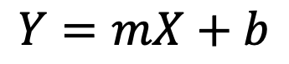
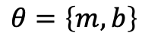
Simple Linear Regression
Y: Response Variable
X: Covariate / Ind., var/Regressors
m: slope
b: bias
Model (Linear)
$$Y=mX+b$$
$$θ=\left\{m,b\right\}$$

Slide 5
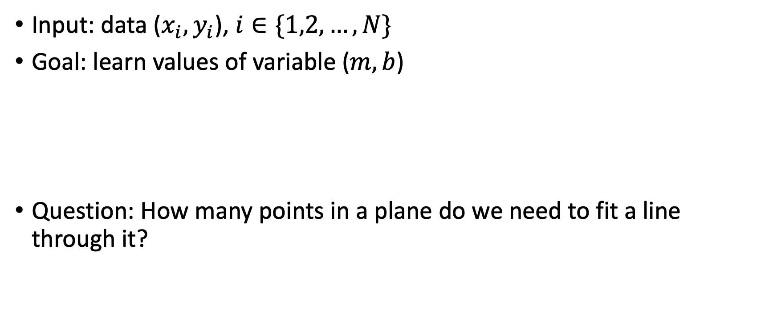
Simple Linear Regression
Input: data ($x_{i}, y_{i}$), $i∈\{1,2,…,N\}$
Goal: learn values of variable ($m,b$)
Question: How many points in a plane do we need to fit a line through it?

Slide 6
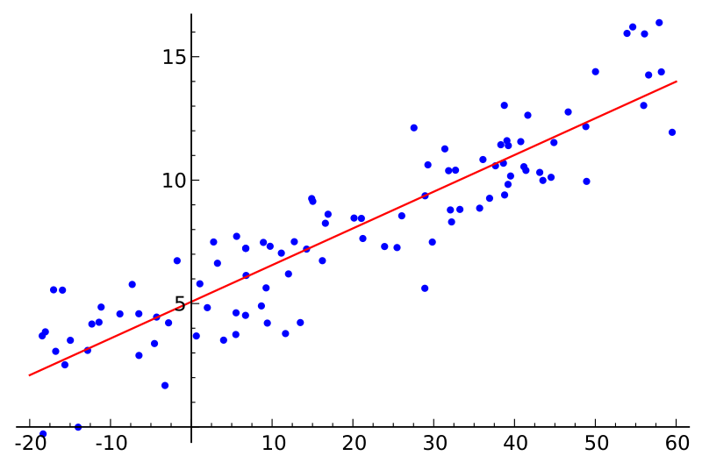
Y
X

Slide 7
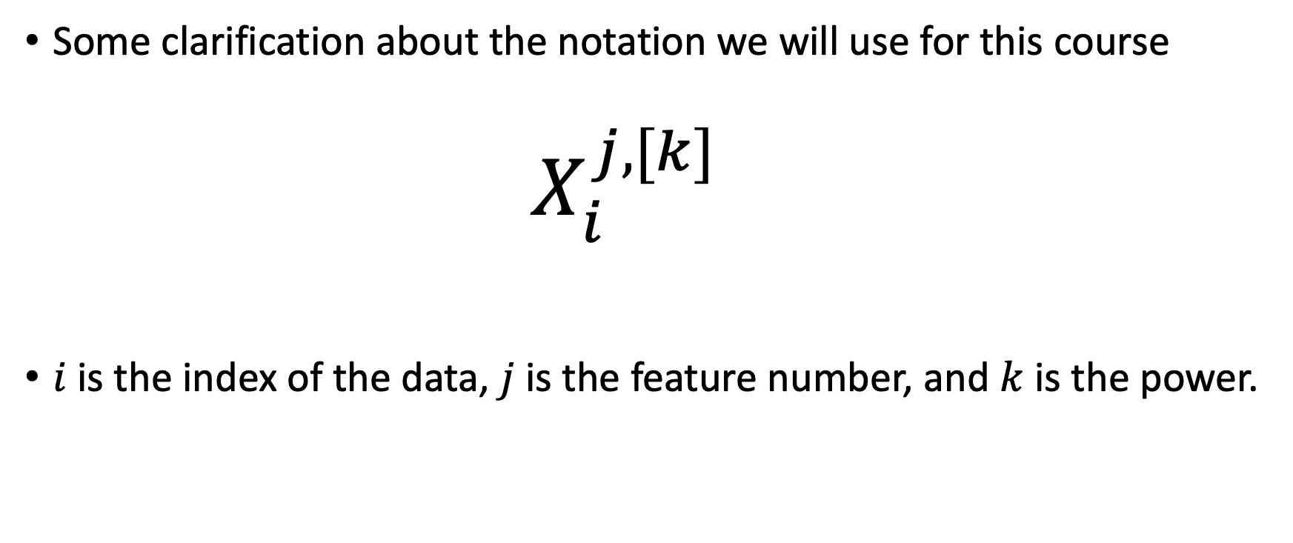
Notation
Some clarification about the notation we will use for this course
$$X_{i}^{j,[k]}$$
$i$is the index of the data, $j$is the feature number, and $k$ is the power.

Slide 8
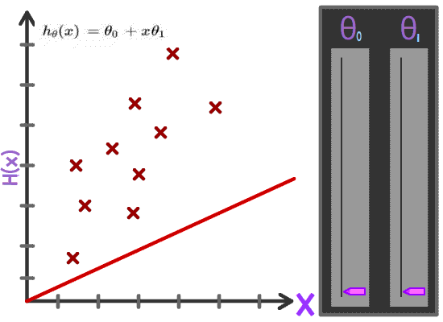
Solution Strategy for Solving the Problem
We want a line which is in some sense the “average line” that represents the data.
Any ideas as to how we can do it?
https://medium.com/analytics-vidhya/machine-learning-intuition-b4b49a671f65

Slide 9
Cost Function
We want to minimize the discrepancy between our model hypothesis and the observed label.
y
x
h_(m,b)
J(m,b)

Slide 10
Intuition of Cost Function
Cost Function
Hypothesis

Slide 11
How to find minima of a function (Review):
Notes:
\frac{d J(m)}{dm} = \frac{d}{dm}\sum_{i=1}^3 (i - mi)^2

Slide 12
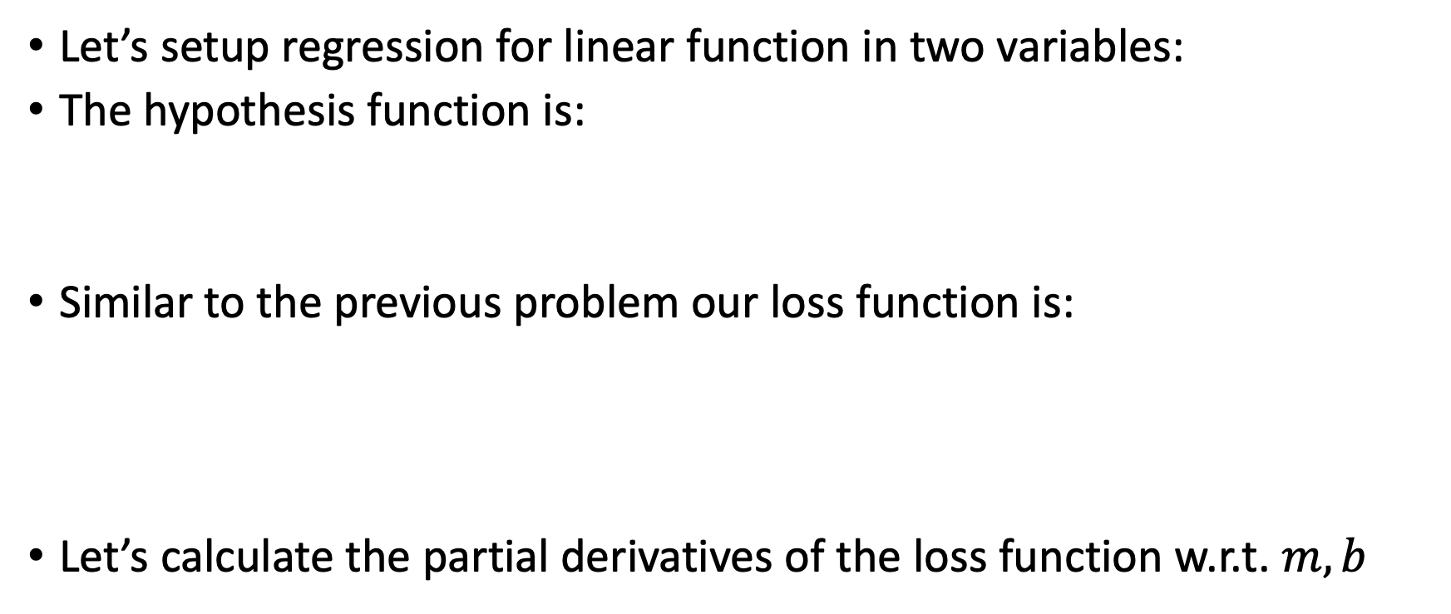
Hypothesis Function with 2 Variables
Let’s setup regression for linear function in two variables:
The hypothesis function is:
Similar to the previous problem our loss function is:
Let’s calculate the partial derivatives of the loss function w.r.t. $m,b$
Notes:
\hat{y_i}=mx_i+b
J = \frac{1}{N} \sum_{i=1}^N (y_i-\hat{y}_i)^2

Slide 13
Gradient of the cost function
We get the following expressions for the gradient of the cost function
Notes:
\frac{\partial J}{\partial m} = \frac{1}{N} \sum_{i=1}^N -2(y_i-\hat{y}_i)x_i
\frac{\partial J}{\partial b} = \frac{1}{N} \sum_{i=1}^N -2(y_i-\hat{y}_i)

Slide 14
Gradient of the cost function
Simplifying the above expressions, we get:
Notes:
\frac{\partial J}{\partial m} = \frac{-2}{N} \sum_{i=1}^N y_ix_i+\frac{2m}{N} \sum_{i=1}^N x_i^2+\frac{2b}{N} \sum_{i=1}^N x_i
\frac{\partial J}{\partial b} = \frac{-2}{N} \sum_{i=1}^N y_i+\frac{2m}{N} \sum_{i=1}^N x_i+\frac{2b}{N} \sum_{i=1}^N 1

Slide 15
Gradient of the cost function
Setting the Gradient equal to 0, and solving for m and b, we get

Slide 16
Issues with the Approach
Calcuting graients like this can quickly become tedious
Each term on either side of the experssion can be written a dot product of two vectors (maybe we can calculate it more efficiently)?
Let’s explore if we can do something better through vectorization
Before, we step into vectorization, let’s consider regression for non-linear functions

Slide 17
Fitting Non-linear Data
What if y is a non-linear function of x, will this approach still work?

Slide 18
Transforming the Feature Space
We can transform features x_{i}
We will apply some non-linear transformation ϕ:
For example, Polynomial transformation:
others: cosine, splines, radial basis functions, etc.
Expert engineered features (modeling)
Notes:
x_i = (x_i^1, x_i^2, x_i^3, ..., x_i^m)
\phi : \mathbb{R}^m \to \mathbb{R}^M
\phi(x_i) = \{1, x_i ^{1}, x_i ^{1,[2]}, ..., x_i ^{1,[k]}, x_i ^{2}, x_i ^{2,[2]}, ..., x_i ^{2,[k]}, ..., x_i ^{m}, x_i ^{m,[2]}, ..., x_i ^{m,[k]} \}

Slide 19
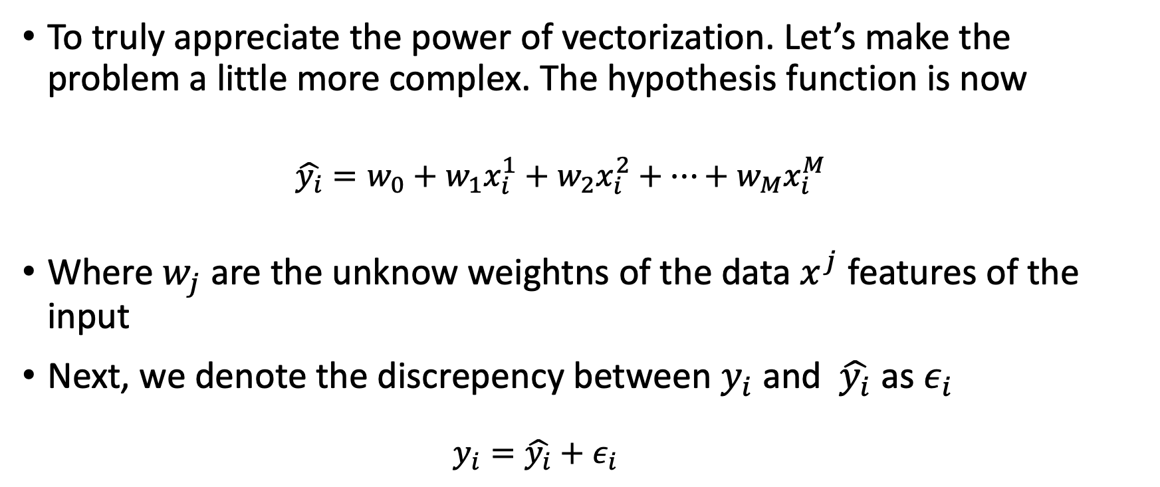
Vectorization
To truly appreciate the power of vectorization. Let’s make the problem a little more complex. The hypothesis function is now
$$\hat{y_{i}}=w_{0}+w_{1}x_{i}^{1}+w_{2}x_{i}^{2}+…+w_{M}x_{i}^{M}$$
Where $w_{j}$ are the unknow weightns of the data $x^{j}$ features of the input
Next, we denote the discrepency between $y_{i}$ and $\hat{y_{i}}$ as $ε_{i}$
$$y_{i}=\hat{y_{i}}+ε_{i}$$

Slide 20
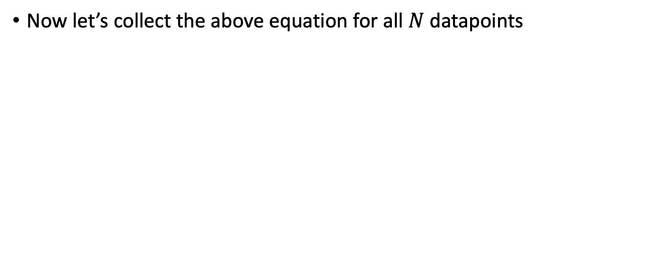
Vectorization
Now let’s collect the above equation for all $N$ datapoints

Slide 21
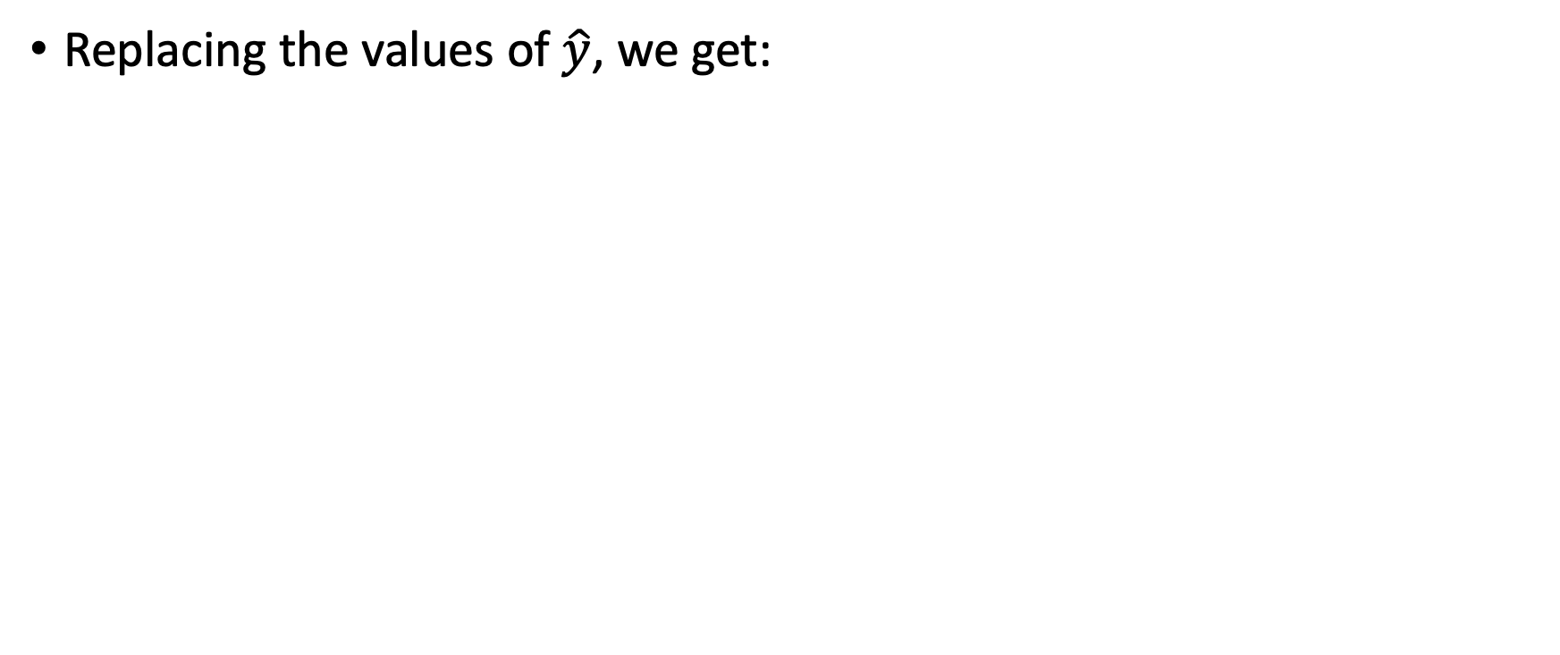
Vectorization
Replacing the values of $\hat{y}$, we get:

Slide 22
Vectorization
Collecting the equations in matrix form:

Slide 23
Vectroization
Notice the rows of the matrix on the right are data samples:

Slide 24
Vectorization
Let’s formalize some notaitons:
Notes:
Show the bias term in X
Discuss the dimension of the matrices/vectors as well as the rank considerations

Slide 25
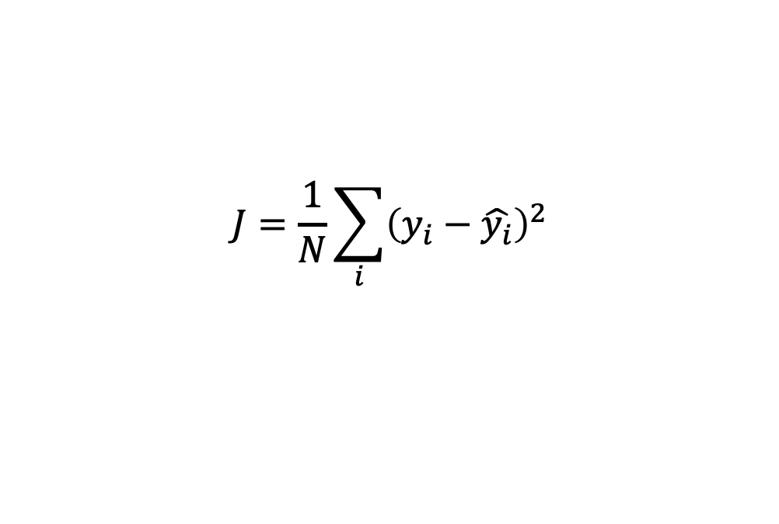
Cost function for the Vectorized form
Notice that we are using the MSE cost function:
Using the defintion of epsilon we can write the above as:
Using the definition of dot product the above can be written as:
$$J=\frac{1}{N}\sum_{i}{{\left(y_{i}−\hat{y_{i}}\right)}^{2}}$$
Notes:
Construct maximum likelihood estimator (MLE):
Derive the log-likelihood
Find θ_{MLE} that maximizes log-likelihood
Analytically: Take derivative and set = 0
Iteratively: (Stochastic) gradient descent

Slide 26
Optimization
The optimization problem is now:
We will use chain rule to calculate the gradient of the cost function:

Slide 27
Linear Least Squares
We get:
Setting it equal to zero we can solve for :
Notes:
\pmb{\theta} = (\pmb{X}^T \pmb{X})^{-1} \pmb{X}^T \pmb{y}

Slide 28
Probalistic Interpretration of Linear Regression and MLE
We can also look at the probalistic Interpretation of Linear Regression.
Keeping everything else same as the previous formulation
Now assume that , then
We can write the conditional distribution as :
Notes:
y_i = \pmb{x}_i^T \pmb{\theta} + \epsilon_i
y_i \sim \mathcal{N}(\pmb{x}_i^T \pmb{\theta},\sigma^{2})\
\text{I\kern-0.15em P}(y_i|\pmb{x}_i)\sim \mathcal{N}(0,\sigma^{2})

Slide 29
Probalistic Interpretation of LR
Let’s assume that all data point in the dataset are i.i.d. (independent identically distributed). Then we have:
Using Bayes Theorem we can write:
Notes:
\text{I\kern-0.15em P}(\mathcal{D}) = \prod_{i=1}^N \text{I\kern-0.15em P}(\pmb{x}_i,y_i)
\prod_{i=1}^N \text{I\kern-0.15em P}(\pmb{x}_i,y_i) = \prod_{i=1}^N \text{I\kern-0.15em P} (\pmb{x}_i)\text{I\kern-0.15em P}(y_i|\pmb{x}_i)

Slide 30
Maximum Likelihoold Estimator
In simple words, given the Dataset we want to find the values of the unknow parameters which maximize the probability of the Dataset.
Using the definition of the conditional distrubtion we have
Using the definition we get
Notes:
\text{I\kern-0.15em P}(y_i|\pmb{x}_i) = \frac{1}{\sigma \sqrt{2\pi}} \exp \left( - (y_i - \pmb{x}_i^T \pmb{\theta}) \right)
\prod_{i=1}^N \text{I\kern-0.15em P}(\pmb{x}_i,y_i) = \prod_{i=1}^N \text{I\kern-0.15em P} (\pmb{x}_i)
\prod_{i=1}^N \frac{1}{\sigma \sqrt{2\pi}} \exp \left( - (y_i - \pmb{x}_i^T \pmb{\theta}) \right)

Slide 31
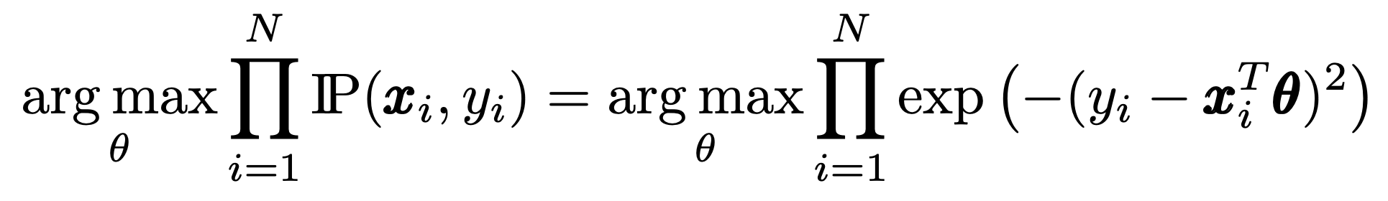
Maximum Likelihood Estimator
Let’s try to maximaize:
Note that
Notes:
\begin{equation*}
\argmax_\theta\prod_{i=1}^N \text{I\kern-0.15em P}(\pmb{x}_i,y_i) = \argmax_\theta\prod_{i=1}^N \exp \left( - (y_i - \pmb{x}_i^T \pmb{\theta})^2 \right)
\end{equation*}

Slide 32
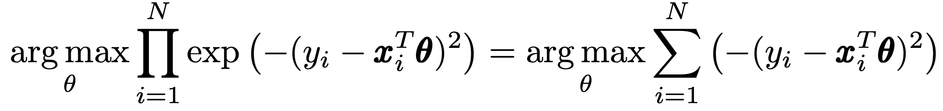
Maximum Likelihood Estimator
Furthermore, since the right hand side of the above equation is monotonice in \theta the arg max will not change if we take log of the expression
Notice that the right hand side is minimizing the MSE.
Hence solution of minimizing the MSE is equivalend to Maximum Likelihood Estimator for linear regression

Slide 33
Error Visualization

Slide 34
Error Visualization
Notes:
Visualization of Normal euationa as solutions

Slide 35
Fitting Non-linear Data
What if Y has a non-linear response?
Can we still use a linear model?

Slide 36
Transforming the Feature Space
Transform features x_{i}
By applying non-linear transformation ϕ:
Example:
others: splines, radial basis functions, …
Expert engineered features (modeling)

Slide 38
What is Bias and Variance?

Slide 39
Real Bad Overfit?

Slide 40
Bias-Variance Tradeoff
So far we have minimized the error (loss) with respect to training data
Low training error does not imply good expected performance: over-fitting
We would like to reason about the expected loss (Prediction Risk) over:
Training Data: {(y₁, x₁), …, (y_{n}, x_{n})}
Test point: (y*, x*)
We will decompose the expected loss into:

Slide 41
Bias-Variance Trade Off (Intuition)
Bias: Bias refers to the error that is introduced by approximating a real-world problem, which may be complex, by a too-simplified model. If a model is too simple and has very few parameters, it might not capture the underlying trends properly, leading to high bias. This usually results in underfitting, where the model performs poorly on both training and new data.
Variance: Variance refers to the error from sensitivity to small fluctuations in the training set. High variance can cause an algorithm to model the random noise in the training data, rather than the intended outputs (overfitting). This happens when the model is too complex, with many parameters relative to the number of observations.

Slide 42
Bias-Variance Trade Off (Intuition)
Imagine you're trying to hit a bullseye with arrows. High bias is like consistently hitting the same spot, but far from the bullseye – your shots are off target in a specific, consistent way. High variance is like your arrows landing all over the target – you're sometimes close to the bullseye, but your shots are inconsistent.
In terms of a model, a high bias, low variance model might consistently miss the mark (poor accuracy), but its predictions are consistent. A high variance, low bias model might hit the target accurately on occasion (potentially good accuracy), but its predictions are all over the place.

Slide 43

Bias Variance Plot
Image from http://scott.fortmann-roe.com/docs/BiasVariance.html
Notes:
Image

Slide 44
Bias Variance Application in Training
Low Complexity (High Bias): Simple models with fewer parameters (like linear regression) are less likely to overfit but might not capture complex patterns in data, leading to underperformance on both training and test data.
High Complexity (High Variance): Complex models with many parameters (like deep neural networks) can capture subtle patterns in the data, but they risk overfitting, where they perform well on training data but poorly on unseen data.
Data, Model, Regularization

Slide 46
Regularization
Slides from: https://harvard-iacs.github.io/2019-CS109A/lectures/lecture8/presentation/Lecture8a_Regularization.pptx

Slide 47
Regularization: An Overview
The idea of regularization revolves around modifying the loss function L; in particular, we add a regularization term that penalizes some specified properties of the model parameters
where $λ$ is a scalar that gives the weight (or importance) of the regularization term.
Fitting the model using the modified loss function L_{reg} would result in model parameters with desirable properties (specified by R).

Slide 48
LASSO Regression
Since we wish to discourage extreme values in model parameter, we need to choose a regularization term that penalizes parameter magnitudes. For our loss function, we will again use MSE.
Together our regularized loss function is:
Note that is the l₁ norm of the vector β

Slide 49
Ridge Regression
Alternatively, we can choose a regularization term that penalizes the squares of the parameter magnitudes. Then, our regularized loss function is:
Note that is the square of the l₂ norm of the vector β

Slide 50
Choosing λ
In both ridge and LASSO regression, we see that the larger our choice of the regularization parameter λ, the more heavily we penalize large values in β,
If λ is close to zero, we recover the MSE, i.e. ridge and LASSO regression is just ordinary regression.
If λ is sufficiently large, the MSE term in the regularized loss function will be insignificant and the regularization term will force β_{ridge} and β_{LASSO} to be close to zero.
To avoid ad-hoc choices, we should select λ using cross-validation.

Slide 51
Ridge, LASSO - Computational complexity
Solution to ridge regression:
The solution to the LASSO regression:
LASSO has no conventional analytical solution, as the L1 norm has no derivative at 0. We can, however, use the concept of subdifferential or subgradient to find a manageable expression. See a–sec2 for details.

Slide 52
Regularization Parameter with a Validation Seet
The solution of the Ridge/Lasso regression involves three steps:
Select λ
Find the minimum of the ridge/Lasso regression loss function (using the formula for ridge) and record the MSE on the validation set.
Find the λ that gives the smallest MSE

Slide 53
The Geometry of Regularization (LASSO)
$$L_{LASSO}\left(β\right)=\frac{1}{n}\sum_{i=1}^{n}{|y_{i}−}β^{T}x{\left.​\right|}^{2}+λ\sum_{j=1}^{J}{|β_{j}|}$$
$${\hat{β}}^{LASSO}=argmin{L_{LASSO}\left(β\right)}$$
$$λ\sum_{j=1}^{J}{\left| {\hat{β}}_{j}^{LASSO}\right|=C}$$
$\frac{1}{n}\sum_{i=1}^{n}{|y_{i}−}{\hat{β}}_{}^{LASSO^{T}}x{\left.​\right|}^{2}$=D
$$β_{2}$$
$$β_{2}$$
C
$${\hat{β}}^{MSE}$$
MSE=D
C
$$β_{1}$$
$$β_{1}$$

Slide 54
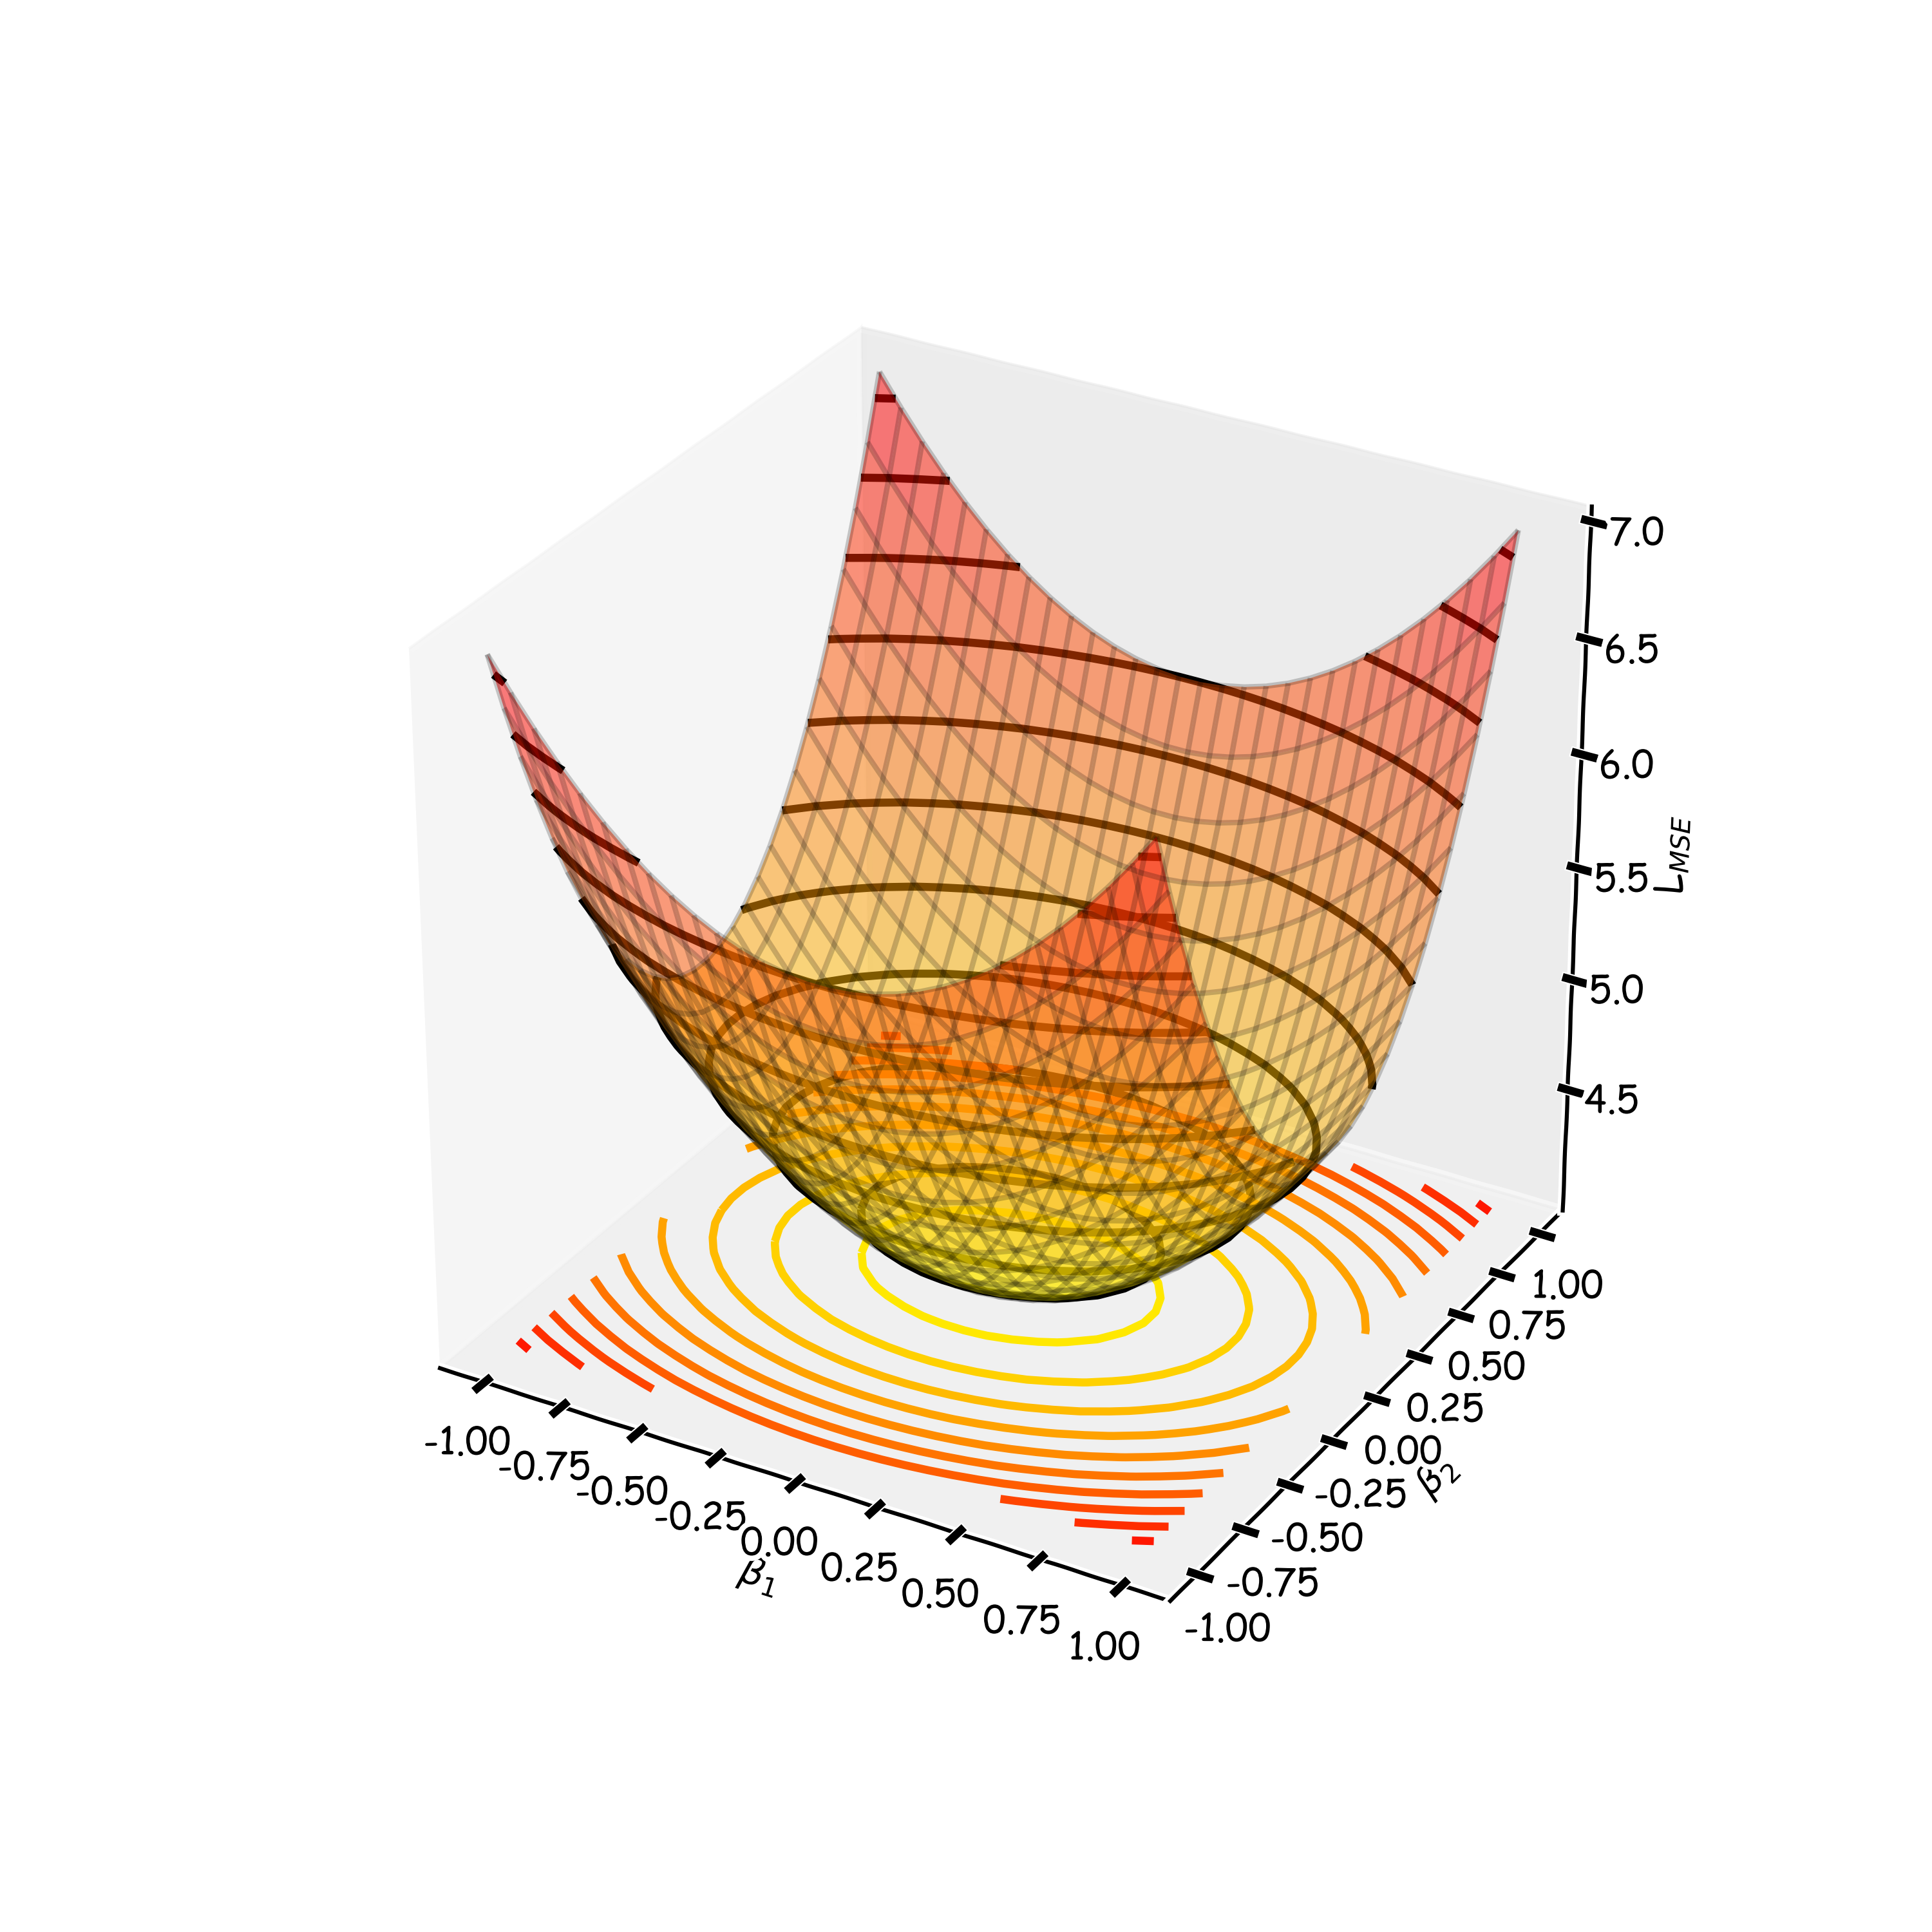
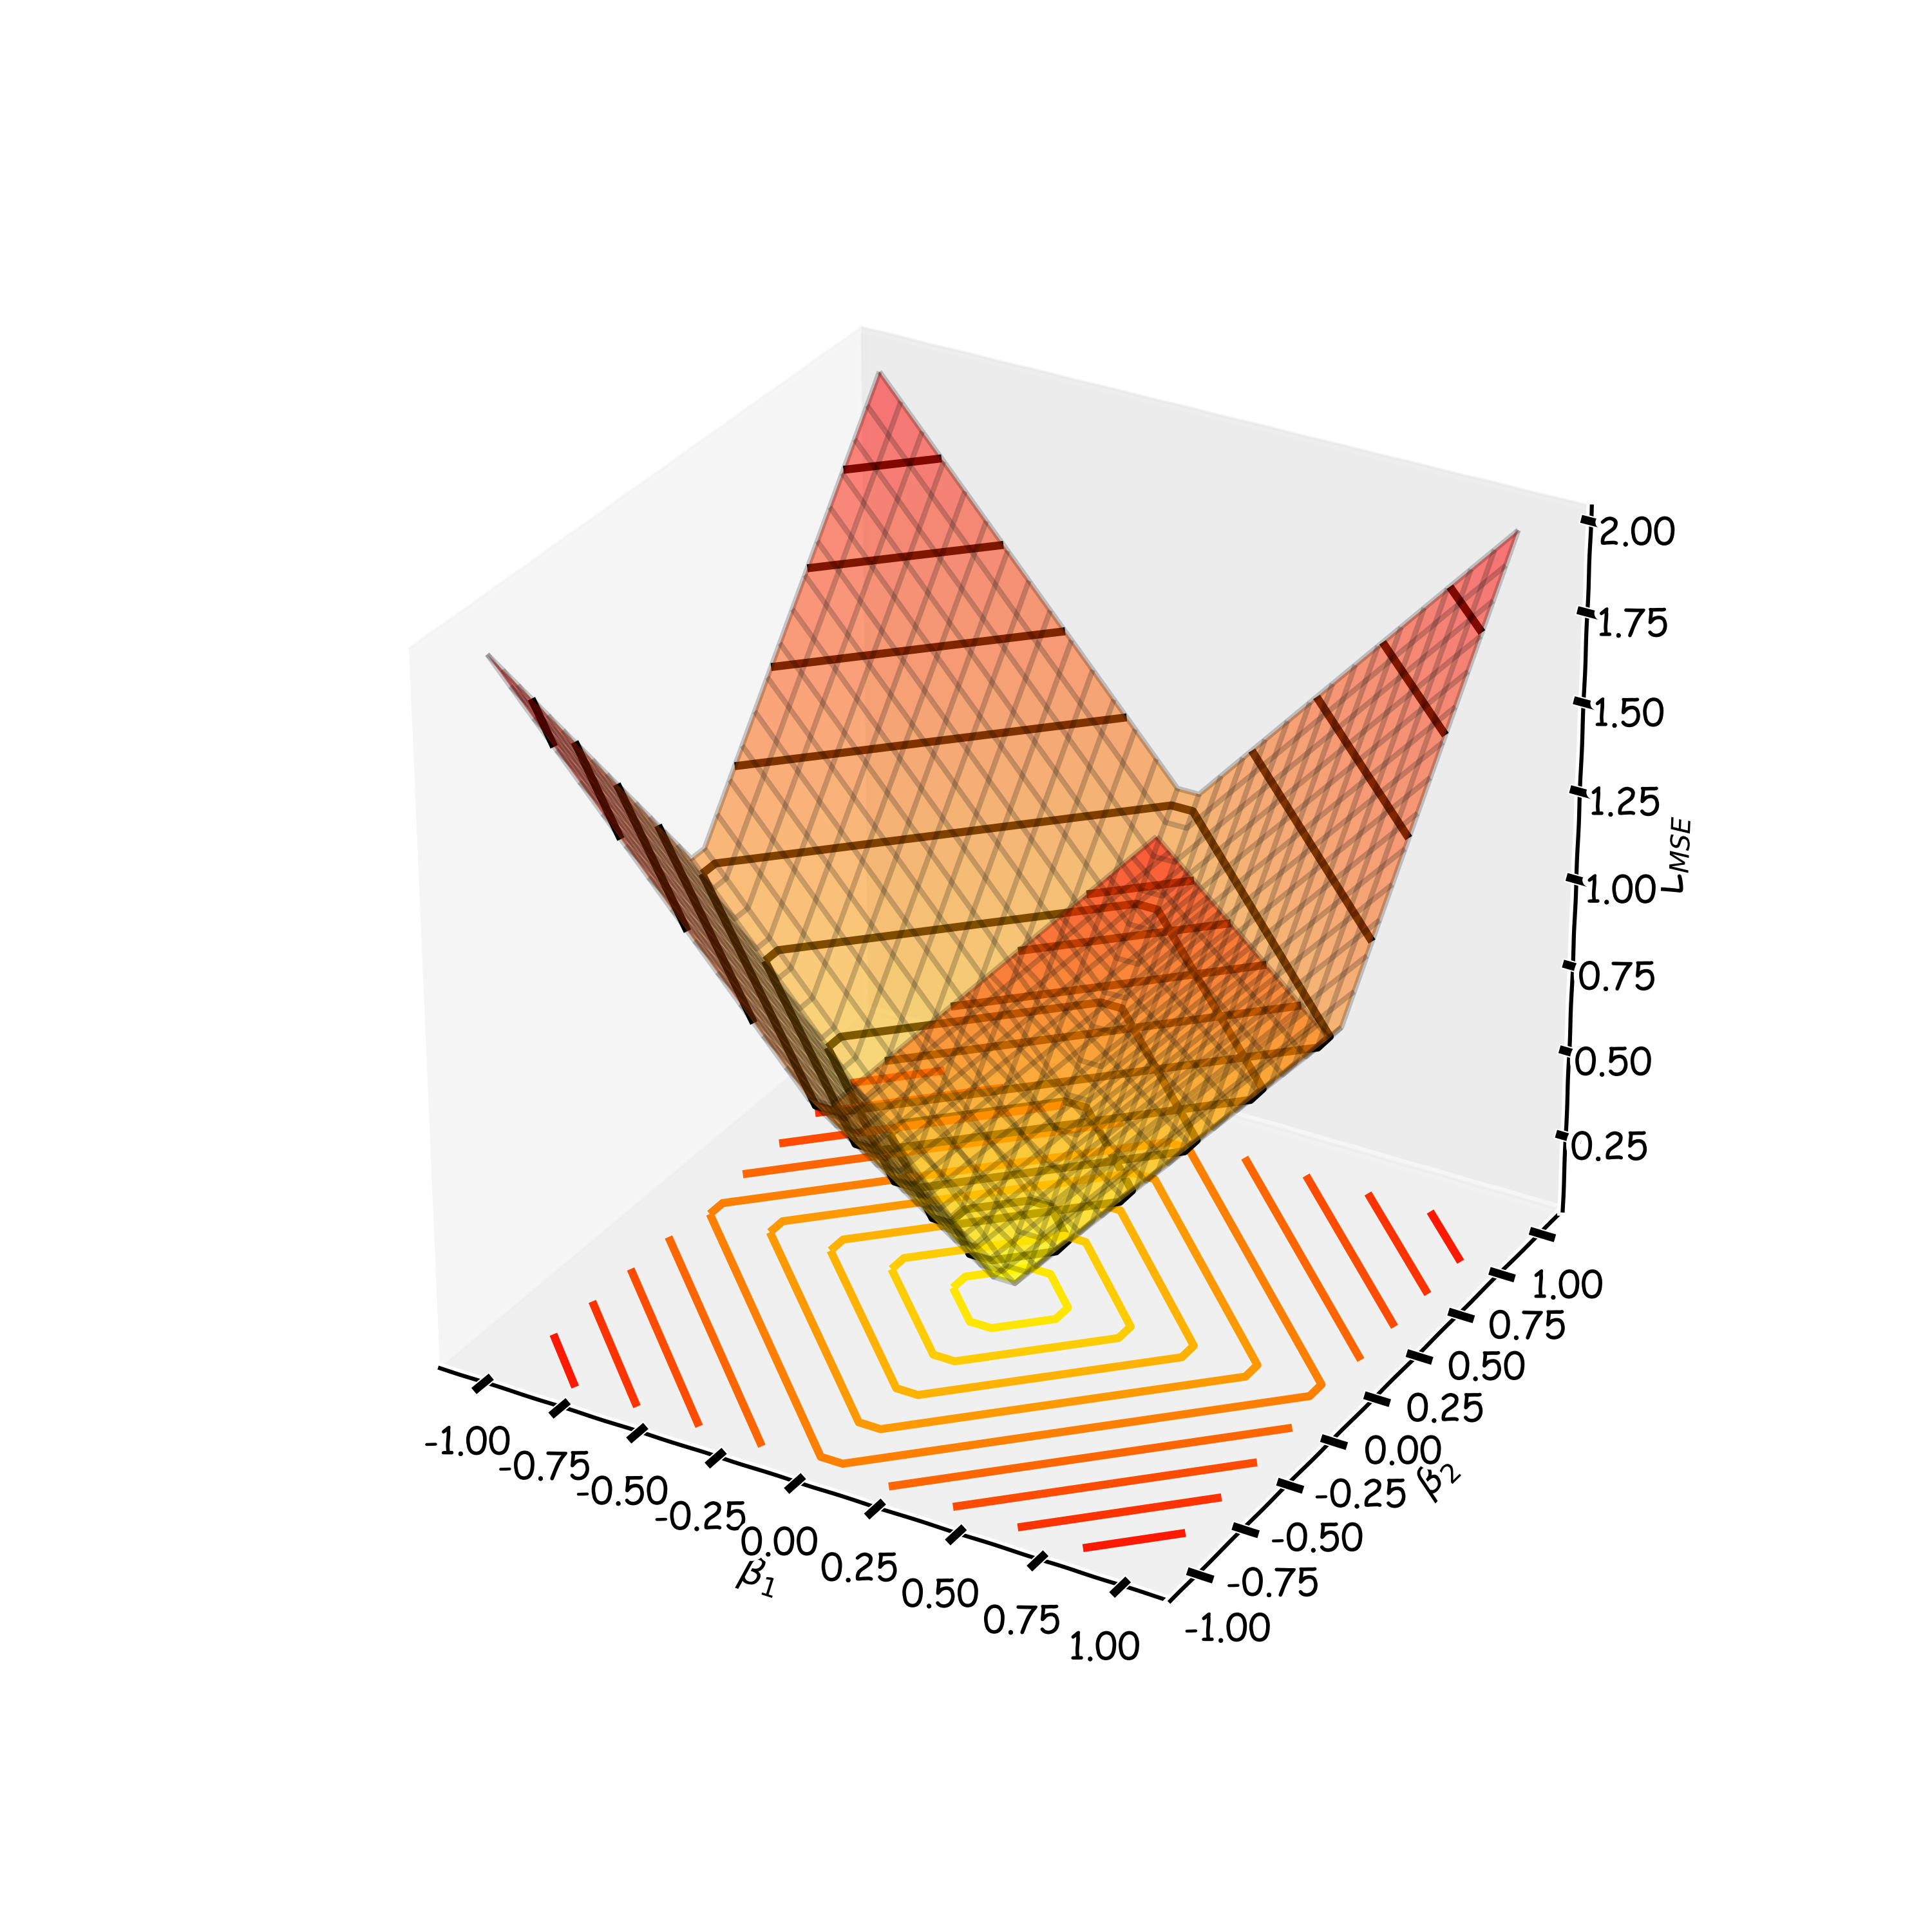
The Geometry of Regularization (LASSO)
$$L_{LASSO}\left(β\right)=\frac{1}{n}\sum_{i=1}^{n}{|y_{i}−}β^{T}x{\left.​\right|}^{2}+λ\sum_{j=1}^{J}{|β_{j}|}$$
$${\hat{β}}^{LASSO}=argmin{L_{LASSO}\left(β\right)}$$
$$L_{1}=λ\sum_{j=1}^{J}{\left| {\hat{β}}_{j}^{LASSO}\right|}$$
$$L_{MSE}\left(β\right)=\frac{1}{n}\sum_{i=1}^{n}{|y_{i}−}β^{T}x{\left.​\right|}^{2}$$

Slide 55
The Geometry of Regularization (LASSO)
$$L_{LASSO}\left(β\right)=\frac{1}{n}\sum_{i=1}^{n}{|y_{i}−}β^{T}x{\left.​\right|}^{2}+λ\sum_{j=1}^{J}{|β_{j}|}$$
$${\hat{β}}^{LASSO}=argmin{L_{LASSO}\left(β\right)}$$
$$λ\sum_{j=1}^{J}{\left| {\hat{β}}_{j}^{LASSO}\right|=C}$$
$\frac{1}{n}\sum_{i=1}^{n}{|y_{i}−}{\hat{β}}_{}^{LASSO^{T}}x{\left.​\right|}^{2}$=D
$$β_{2}$$
$$β_{2}$$
C
$${\hat{β}}^{MSE}$$
MSE=D
C
$$β_{1}$$
$$β_{1}$$

Slide 56
The Geometry of Regularization (LASSO)
$$β_{2}$$
$$β_{2}$$
$$β_{2}$$
$${\hat{β}}^{MSE}$$
MSE=D
C
C
$${\hat{β}}^{MSE}$$
MSE=D
C
C
$$β_{1}$$
$$β_{1}$$
$$β_{1}$$

Slide 57
The Geometry of Regularization (Ridge)
$$L_{Ridge}\left(β\right)=\frac{1}{n}\sum_{i=1}^{n}{|y_{i}−}β^{T}x{\left.​\right|}^{2}+λ\sum_{j=1}^{J}{{\left(β_{j}\right)}^{2}}$$
$${\hat{β}}^{Ridge}=argmin{L_{Ridge}\left(β\right)}$$
$$λ\sum_{j=1}^{J}{{\left|{\hat{β}}_{j}^{Ridge}\right|}^{2}=C}$$
$\frac{1}{n}\sum_{i=1}^{n}{|y_{i}−}{\hat{β}}_{}^{{Ridge}^{T}}x{\left.​\right|}^{2}$=D
$$β_{2}$$
$$β_{2}$$
$${\hat{β}}^{MSE}$$
MSE=D
C
$$β_{1}$$
$$β_{1}$$

Slide 58
The Geometry of Regularization (Ridge)
$$β_{2}$$
$${\hat{β}}^{MSE}$$
MSE=D
C
$$β_{1}$$

Slide 59
The Geometry of Regularization
$$β_{2}$$
$$β_{2}$$
$${\hat{β}}^{MSE}$$
MSE=D
$${\hat{β}}^{MSE}$$
MSE=D
C
C
C
$$β_{1}$$
$$β_{1}$$

Slide 60
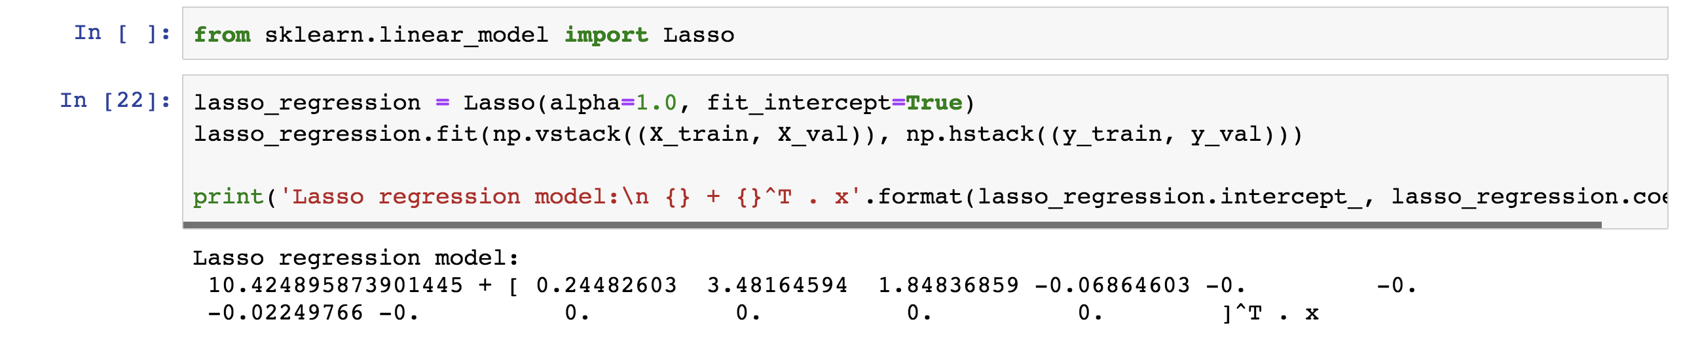
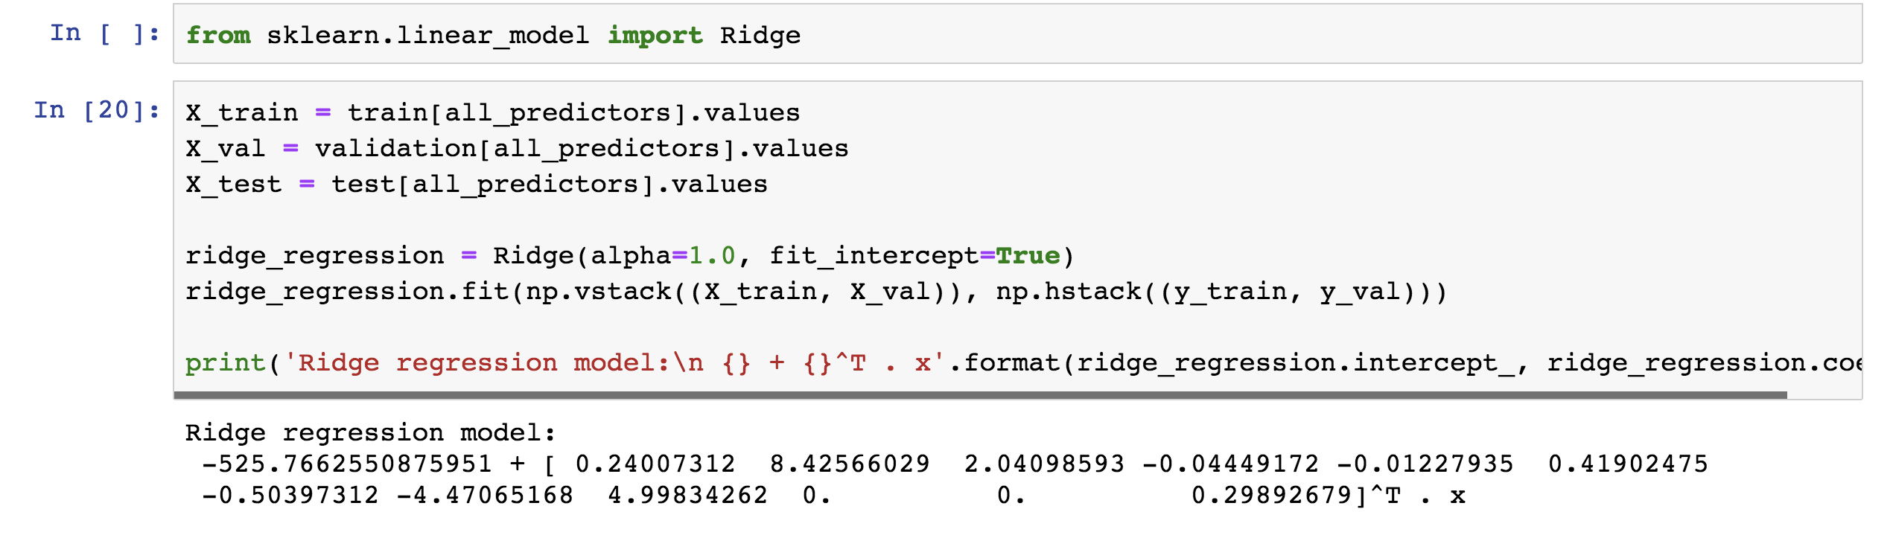
Examples

Slide 61
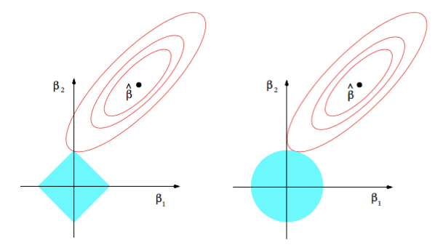
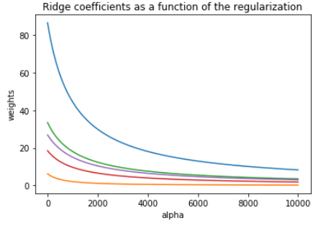
Ridge visualized
Ridge estimator
The ridge estimator is where the constraint and the loss intersect.
The values of the coefficients decrease as lambda increases, but they are not nullified.

Slide 62
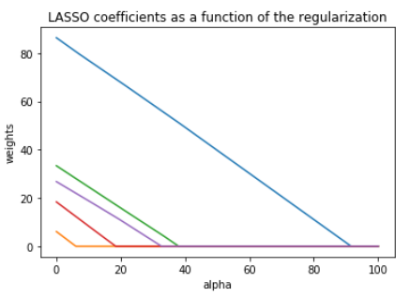
LASSO visualized
Lasso estimator
The Lasso estimator tends to zero out parameters as the OLS loss can easily intersect with the constraint on one of the axis.
The values of the coefficients decrease as lambda increases, and are nullified fast.

Slide 63
Ridge regularization with only validation : step by step
split data into $\{{\left\{X,Y\right\}}_{train},{\left\{X,Y\right\}}_{validation},{\left\{X,Y\right\}}_{test}\}$
for $λ in \left\{λ_{min},…λ_{max}\right\}:$
determine the $β$ that minimizes the $L_{ridge}$, ${\hat{β}}_{Ridge}\left(λ\right)={\left(X^{T}X+λI\right)}^{−1}X^{T}Y$ , using the train data.
record $L_{MSE}^{}\left(λ\right)$ using validation data.
select the $λ$that minimizes the loss on the validation data, $λ_{ridge}={argmin}_{λ} L_{MSE}^{}\left(λ\right)$
Refit the model using both train and validation data, $\{{\left\{X,Y\right\}}_{train},{\left\{X,Y\right\}}_{validation}$ }, resulting to ${\hat{β}}_{ridge}\left(λ_{ridge}\right)$
report MSE or R² on ${\left\{X,Y\right\}}_{test}$ given the ${\hat{β}}_{ridge}\left(λ_{ridge}\right)$

Slide 64
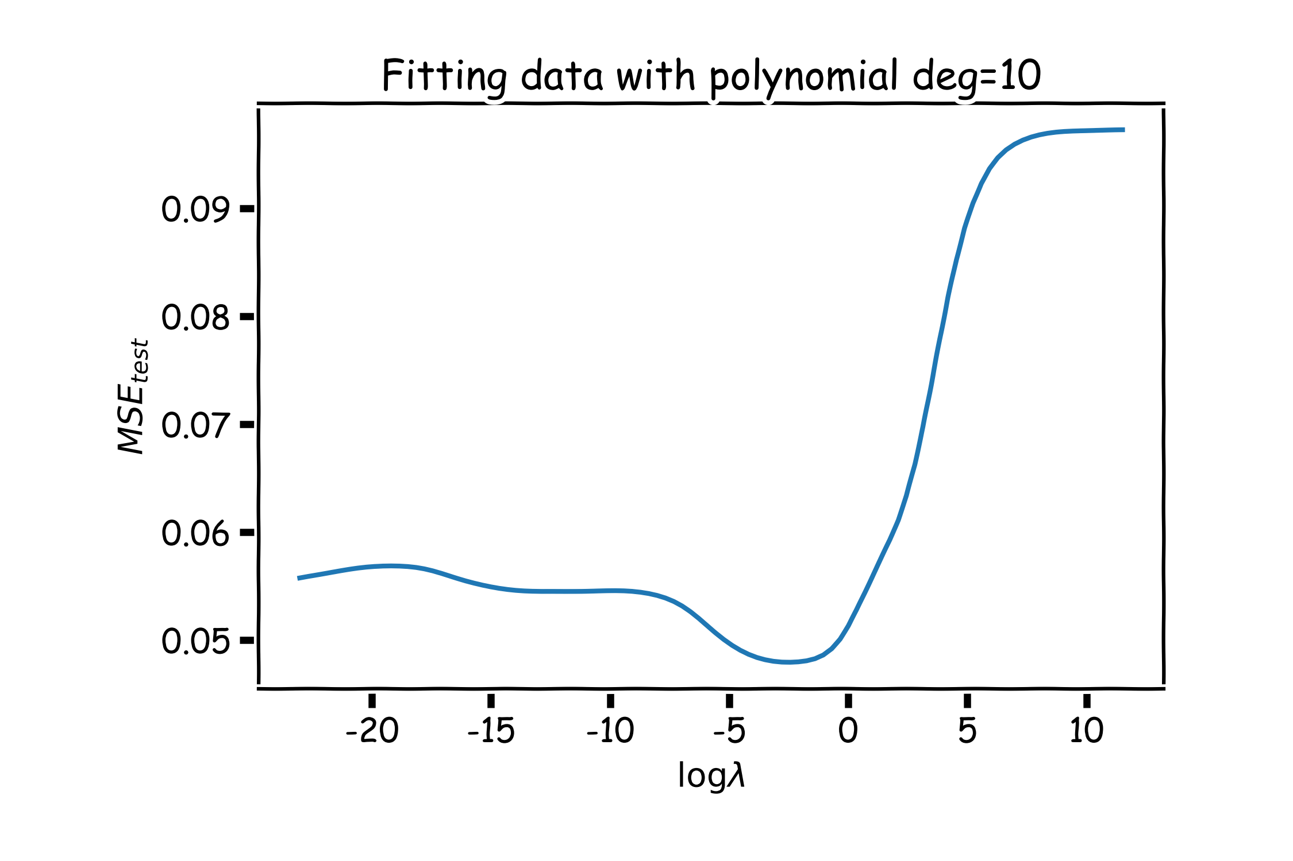
Ridge regularization with validation only: step by step
val

Slide 65
Lasso regularization with validation only: step by step
split data into $\{{\left\{X,Y\right\}}_{train},{\left\{X,Y\right\}}_{validation},{\left\{X,Y\right\}}_{test}\}$
for $λ in \left\{λ_{min},…λ_{max}\right\}:$
determine the $β$ that minimizes the $L_{lasso}$, ${\hat{β}}_{lasso}\left(λ\right)$, using the train data. This is done using a solver.
record $L_{MSE}^{}\left(λ\right)$ using validation data
select the $λ$that minimizes the loss on the validation data, ${ λ}_{lasso}={argmin}_{λ} L_{MSE}^{}\left(λ\right)$
Refit the model using both train and validation data, $\{{\left\{X,Y\right\}}_{train},{\left\{X,Y\right\}}_{validation}$ }, resulting to ${\hat{β}}_{lasso}\left(λ_{lasso}\right)$
report MSE or R² on ${\left\{X,Y\right\}}_{test}$ given the ${\hat{β}}_{lasso}\left(λ_{lasso}\right)$

Slide 66
Ridge regularization with CV: step by step
 | $$λ_{1}$$ | $$λ_{2}$$ | … | $$λ_{n}$$
$$k_{1}$$
$$k_{2}$$
…
$$k_{n}$$
 | $$λ_{1}$$ | $$λ_{2}$$ | … | $$λ_{n}$$
$$k_{1}$$ | $$L_{11}$$ | $$L_{12}$$ | .. | …
$$k_{2}$$ | $$L_{21}$$ | … | .. | …
… | .. | … | .. | …
$$k_{n}$$ | … | … | … | …
E[] | $${\overline{L}}_{1}$$ | $${\overline{L}}_{2}$$ | … | $${\overline{L}}_{n}$$
 | $$λ_{1}$$ | $$λ_{2}$$ | … | $$λ_{n}$$
$$k_{1}$$
$$k_{2}$$
…
$$k_{n}$$
 | $$λ_{1}$$ | $$λ_{2}$$ | … | $$λ_{n}$$
$$k_{1}$$ | $$L_{11}$$ | $$L_{12}$$ | .. | …
$$k_{2}$$ | $$L_{21}$$ | … | .. | …
… | .. | … | .. | …
$$k_{n}$$ | … | … | … | …
 | $$λ_{1}$$ | $$λ_{2}$$ | … | $$λ_{n}$$
$$k_{1}$$ | $$L_{11}$$
$$k_{2}$$
…
$$k_{n}$$
 | $$λ_{1}$$ | $$λ_{2}$$ | … | $$λ_{n}$$
$$k_{1}$$ | $$L_{11}$$ | $$L_{12}$$ | .. | …
$$k_{2}$$ | $$L_{21}$$ | … | .. | …
… | .. | … | .. | …
$$k_{n}$$ | … | … | … | …
E[] | $${\overline{L}}_{1}$$ | $${\overline{L}}_{2}$$ | … | $${\overline{L}}_{n}$$
 | $$λ_{1}$$ | $$λ_{2}$$ | … | $$λ_{n}$$
$$k_{1}$$
$$k_{2}$$
…
$$k_{n}$$
remove ${\left\{X,Y\right\}}_{test}$ from data
split the rest of data into K folds, $\{{\left\{X,Y\right\}}_{train}^{−k},{\left\{X,Y\right\}}_{val}^{k}\}$
for k in $\left\{1,…,K\right\}$
for $λ in \left\{λ_{0,}…{, λ}_{n}\right\}:$
determine the $β$ that minimizes the $L_{ridge}$, ${\hat{β}}_{ridge}\left(λ,k\right)={\left(X^{T}X+λI\right)}^{−1}X^{T}Y$ , using the train data of the fold, ${\left\{X,Y\right\}}_{train}^{−k}$.
record $L_{MSE}^{}\left(λ,k\right)$ using the validation data of the fold ${\left\{X,Y\right\}}_{val}^{k}$
At this point we have a 2-D matrix, rows are for different k, and columns are for different $λ$ values.
Average the $L_{MSE}(λ,k)$ for each $λ$, ${{\overline{L}}_{MSE}\left(λ\right)}_{}$.
Find the $λ$ that minimizes the ${{\overline{L}}_{MSE}\left(λ\right)}_{}$, resulting to $λ_{ridge}$.
Refit the model using the full training data, $\{{\left\{X,Y\right\}}_{train},{\left\{X,Y\right\}}_{val}$ }, resulting to ${\hat{β} }_{ridge}\left(λ_{ridge}\right)$
report MSE or R² on ${\left\{X,Y\right\}}_{test}$ given the ${\hat{β}}_{ridge}\left(λ_{ridge}\right)$

Slide 67
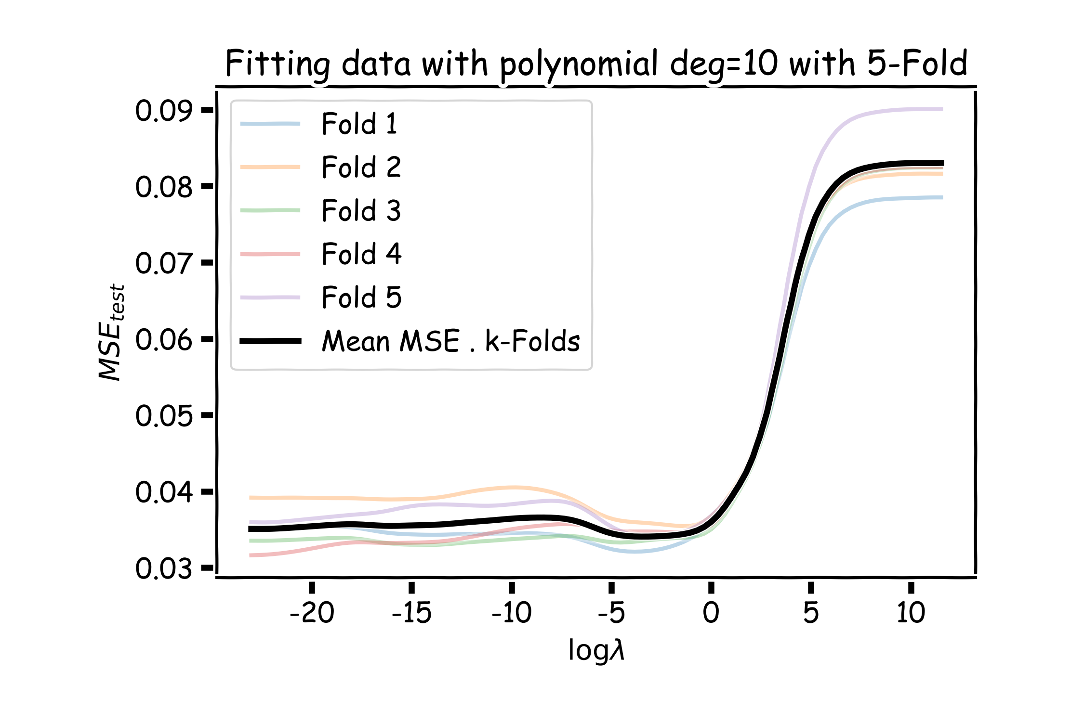
Ridge regularization with validation only: step by step
val

Slide 68
Variable Selection as Regularization
Since LASSO regression tend to produce zero estimates for a number of model parameters - we say that LASSO solutions are sparse - we consider LASSO to be a method for variable selection.
Many prefer using LASSO for variable selection (as well as for suppressing extreme parameter values) rather than stepwise selection, as LASSO avoids the statistic problems that arises in stepwise selection.
Question: What are the pros and cons of the two approaches?

